Slide 1
The Experience
of Learning to Write

Slide 2
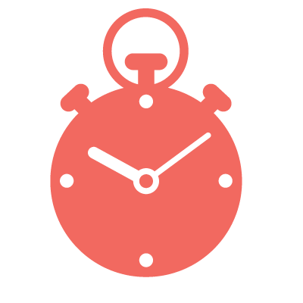



What does writing look like today?
TIME PRESSURES
PLAGIARISM
WRITING ASSESSMENTS
ILLEGIBLE COMMENTS
Notes:
Yet the process of writing is broken for today’s students.
Writing should be an enriching process and not a series of terrifying events.
It starts with time pressures. Instructors do not have the time to provide one-to-one feedback as students write. And students are often at a loss on how to revise and improve their writing without guidance. They end up treating writing as an event, rather than a process.
These time pressures can create problems once the paper is submitted; namely, the problem of plagiarism. Numerous studies have provided that time pressures is a leading cause of unethical decision making.
Another challenge is around feedback. Feedback is most effective when it is timely, specific, focused and accessible. Yet many students are still faced with deciphering illegible comments and trying to understand what “awk” means.
Finally, students are being assessed more and more based on what they learned over the course of this very challenged process. Yet, it is becoming clear that the means by which we assess student writing is not always fair or reliability and can often take months before results are returned.
This is a pretty bleak picture and we want to share with you our vision for how to improve this process.

Slide 3
What to do with these challenges?
Promote
Original Writing
Encourage students to
take ownership of their ideas
Evaluate and Deliver Personalized
Feedback
Engage students and
promote critical thinking

Slide 4
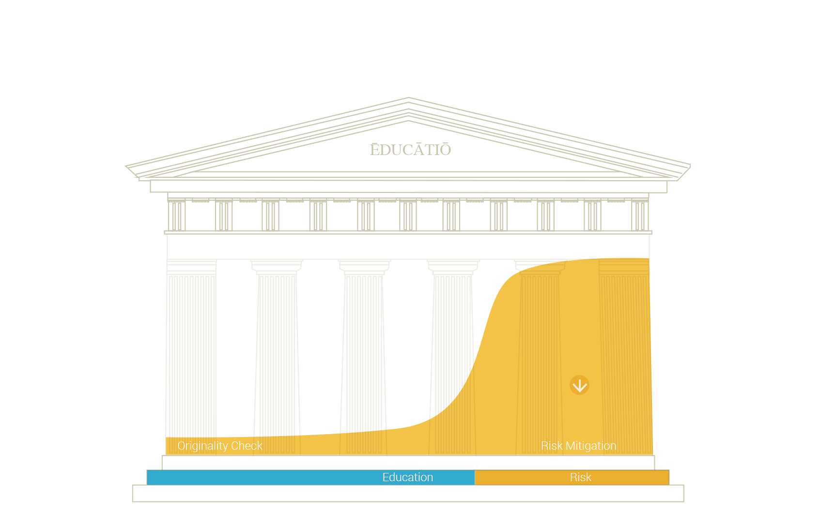
Freshman
Sophomore
Bachelor
Master
PhD

Slide 5
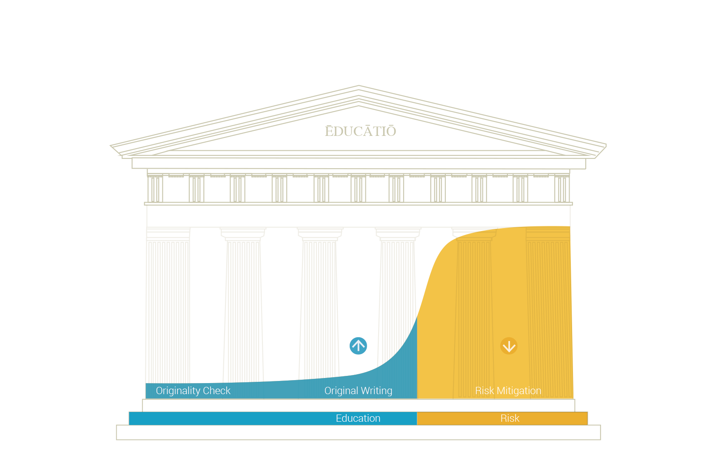
Freshman
Sophomore
Bachelor
Master
PhD

Slide 6
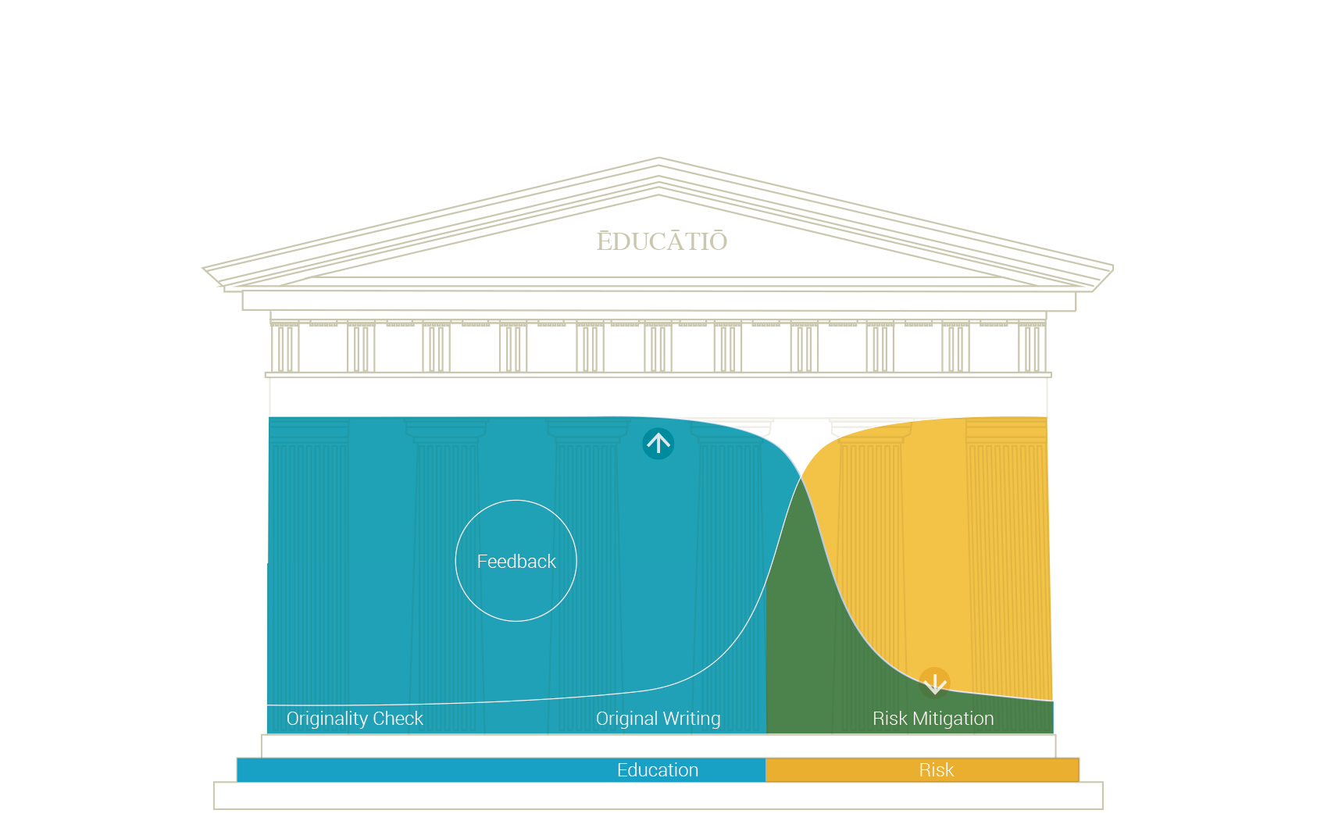
Freshman
Sophomore
Bachelor
Master
PhD

Slide 7
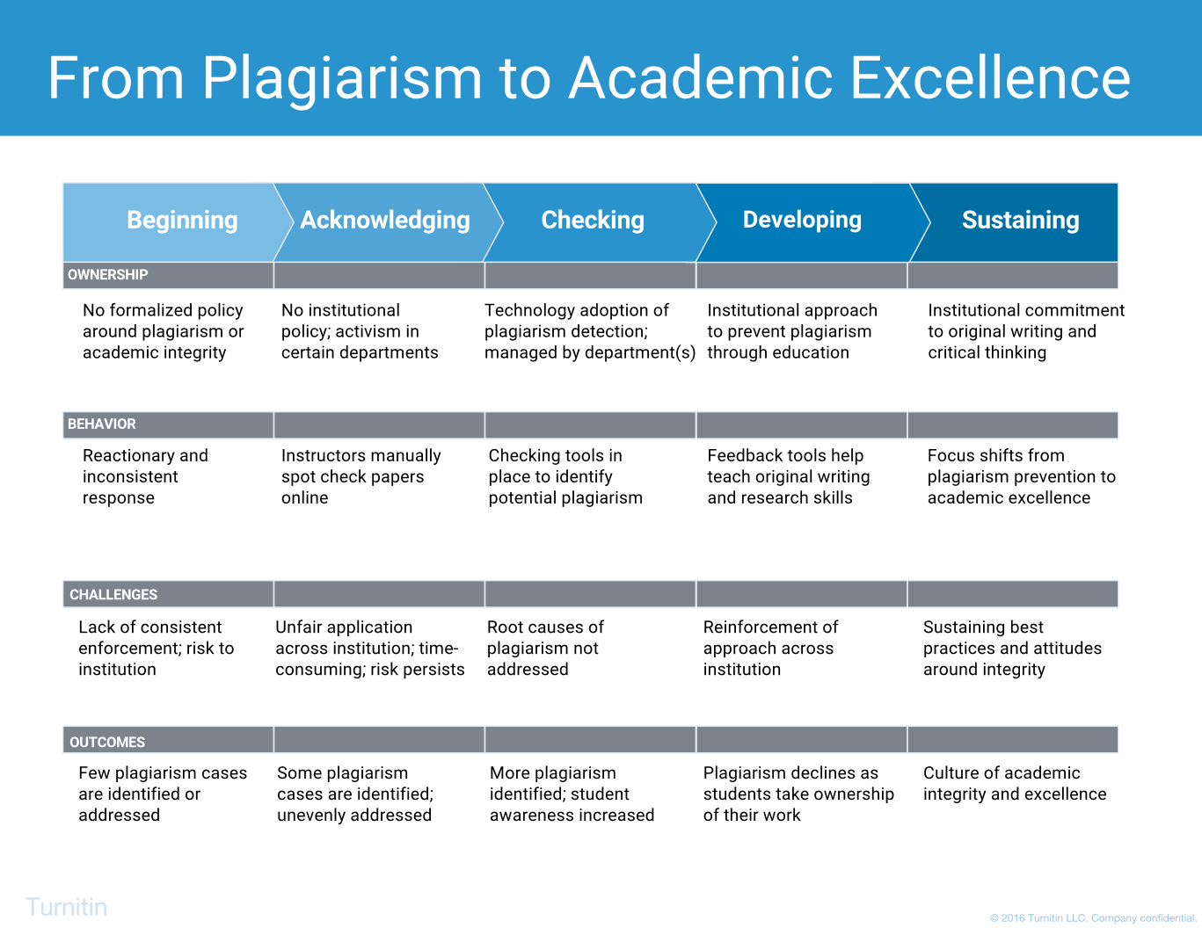

Slide 8


”
Originality Check
Grading
and Feedback
A lot of problems with
getting feedback to students
in a good way have been
solved by Turnitin.
Jennifer Lowood
Instructor, Berkeley City College
Turnitin Feedback Studio
Great Feedback, Fast.

Slide 9

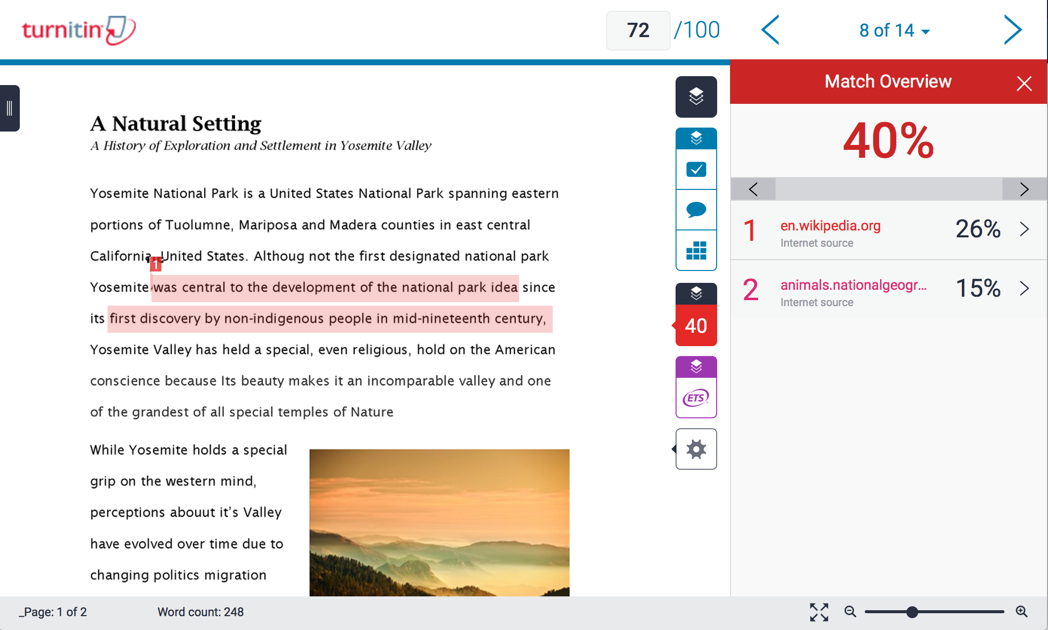
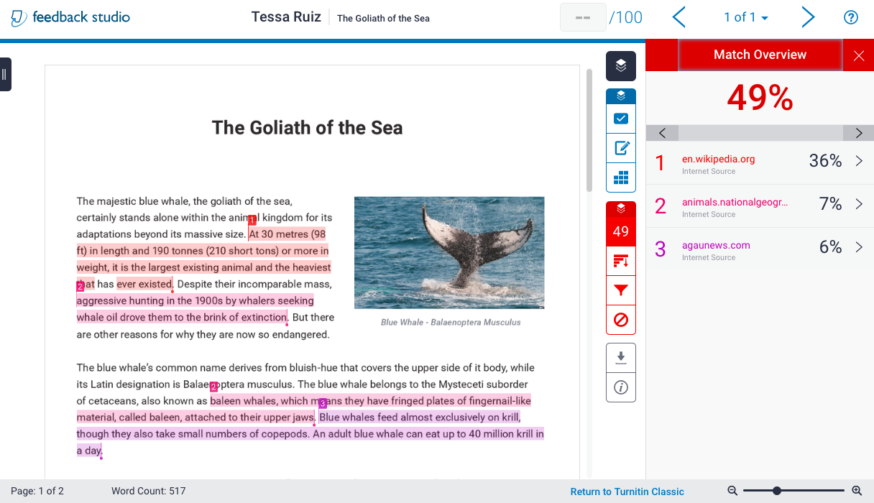



Turnitin Feedback Studio- Originality Checking
© 2015 Turnitin LLC. Company confidential.
60B Web Pages
160M Scholarly Articles
600M Student Papers
Notes:
Turnitin Evaluation Space contains the world’s largest academic comparison database.

Slide 10
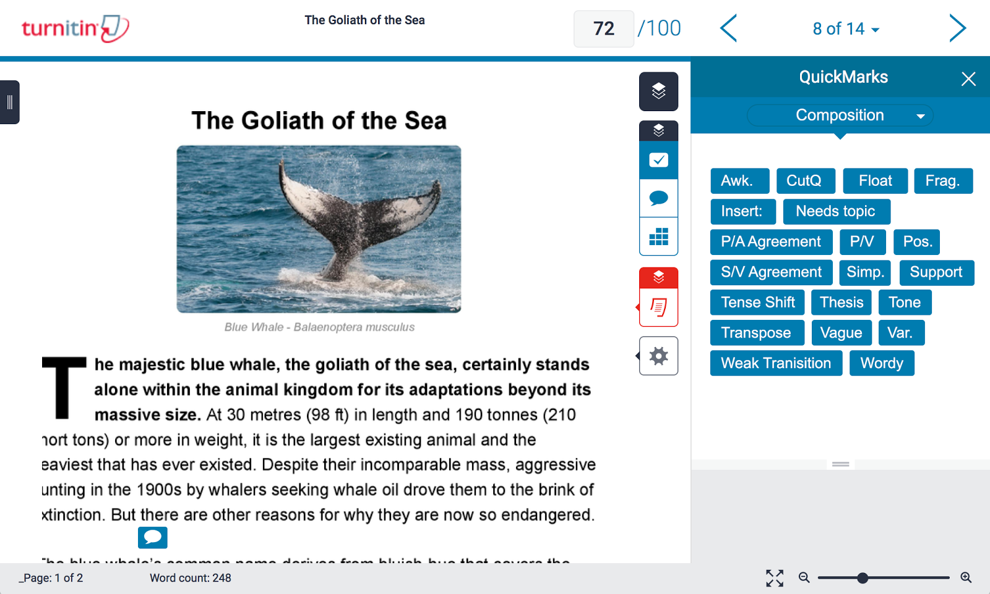


Turnitin Feedback Studio- Five Types of Feedback
© 2015 Turnitin LLC. Company confidential.
Originality report Quickmark sets Voice comments Summary comments Grading rubrics
Notes:
Here is a look at the new user interface which places the focus on the paper and allows instructors to toggle between different feedback layers.
The different services within Turnitin Evaluation Space are color coded and easily show users when they are activated.
Viewing and navigating across the submission is much cleaner as well. Users can easily enlarge the submission with zoom capabilities in the bottom right of the screen. They can also more quickly navigate through the document with pagination features which show what page the viewer is on relative to the total number of pages in the document.
Voice comments really surprised us, students love it, but teachers are apprehensive. “who likes to hear his own school”.

Slide 11
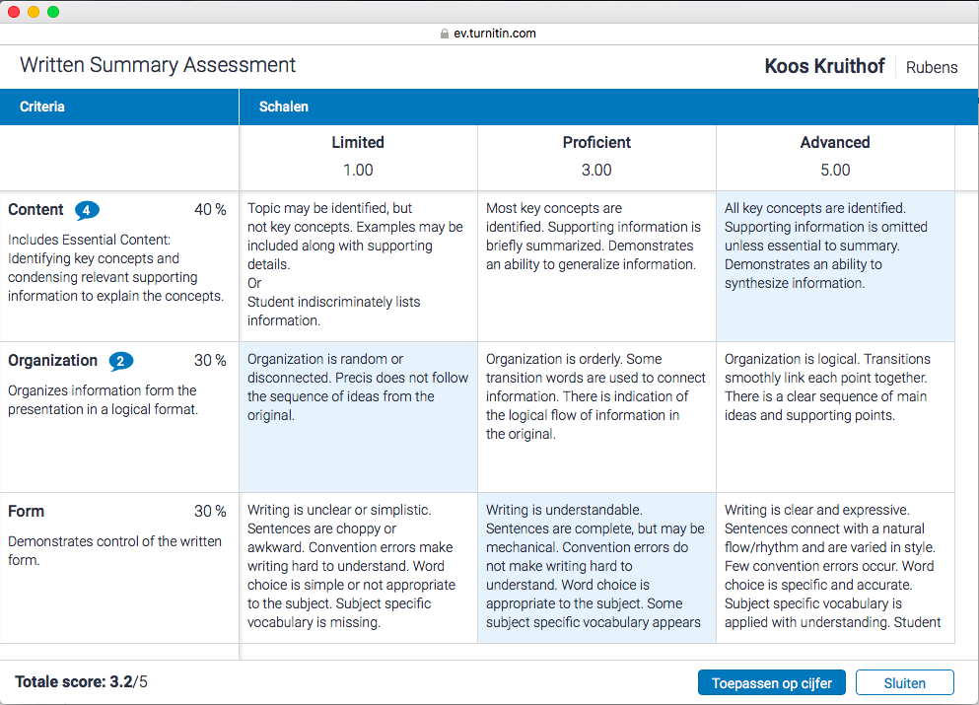
Turnitin Feedback Studio- Rubrics
© 2015 Turnitin LLC. Company confidential.
Notes:
Here is a look at the new user interface which places the focus on the paper and allows instructors to toggle between different feedback layers.
The different services within Turnitin Evaluation Space are color coded and easily show users when they are activated.
Viewing and navigating across the submission is much cleaner as well. Users can easily enlarge the submission with zoom capabilities in the bottom right of the screen. They can also more quickly navigate through the document with pagination features which show what page the viewer is on relative to the total number of pages in the document.
Voice comments really surprised us, students love it, but teachers are apprehensive. “who likes to hear his own school”.

Slide 12


Turnitin Revision Assistant
Write. Get Feedback. Improve.
Originality Check
Grading
and Feedback
Turnitin Feedback Studio
Great Feedback, Fast.
Turnitin Scoring Engine
Assessments Made Simple
Notes:
Turnitin Scoring Engine learns from the feedback and grades your instructors have provided to students to create a customized scoring engine that is instant, reliable and tailored to your needs.

Slide 13
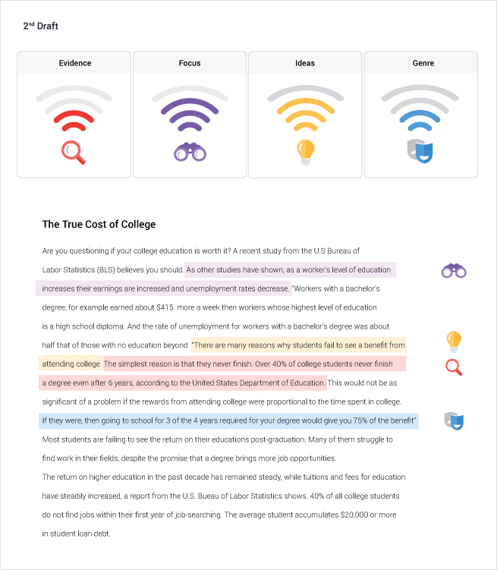
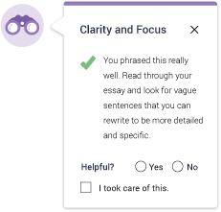
Turnitin Revision Assistant - Write. Get Feedback. Improve.
© 2015 Turnitin LLC. Company confidential.
Signal Checks
Overall assessment prediction
Inline Comments
Specific, instant feedback
Highlights
Shows where students need to focus
Notes:
Revision Assistant generates assessment predictions, shown to students as graphic "Signal Checks" instead of scores. It also generates in-line comments targeted to a student's writing, focusing on elements of argument, evidence, genre and clarity of student writing. The system provides instant feedback to students, offering both positive as well as constructive feedback.

Slide 14
Turnitin Revision Assistant
Write. Get Feedback. Improve.
Originality Check
Grading
and Feedback
Turnitin Feedback Studio
Great Feedback, Fast.
Turnitin Scoring Engine
Assessments Made Simple
Notes:
So that covers it. This is Turnitin’s vision for revolutionizing the experience of writing to learn.

Slide 15
Revolutionising
the Experience
of Writing to Learn
Notes:
I am happy to answer any questions you may have.

