Slide 1
Quality means avoiding irrelevance
Jaakko Kurhila, Director of the open university
Chairman of the teachers’ academy
Notes:
The Teachers' Academy logo, the acorn, stands for knowledge, a new beginning and the spread of wisdom. It is a sign of the distinguished university teacher as an inspirer of learning.
The oak tree, a symbol of knowledge and wisdom, stands for community and the Teachers' Academy as a network of scholarly teachers. It evokes the idea of a university community that is proud of its teachers, appreciates their skills and encourages them in their quest for better teaching.

Slide 2
everything is only two clicks away
Notes:
The Teachers' Academy logo, the acorn, stands for knowledge, a new beginning and the spread of wisdom. It is a sign of the distinguished university teacher as an inspirer of learning.
The oak tree, a symbol of knowledge and wisdom, stands for community and the Teachers' Academy as a network of scholarly teachers. It evokes the idea of a university community that is proud of its teachers, appreciates their skills and encourages them in their quest for better teaching.

Slide 3
irrelevance?
Notes:
The Teachers' Academy logo, the acorn, stands for knowledge, a new beginning and the spread of wisdom. It is a sign of the distinguished university teacher as an inspirer of learning.
The oak tree, a symbol of knowledge and wisdom, stands for community and the Teachers' Academy as a network of scholarly teachers. It evokes the idea of a university community that is proud of its teachers, appreciates their skills and encourages them in their quest for better teaching.

Slide 4
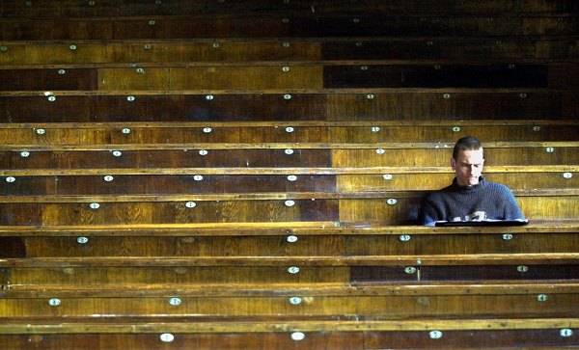

Slide 5
we need to argue the relevance to students, day in, day out
Notes:
The Teachers' Academy logo, the acorn, stands for knowledge, a new beginning and the spread of wisdom. It is a sign of the distinguished university teacher as an inspirer of learning.
The oak tree, a symbol of knowledge and wisdom, stands for community and the Teachers' Academy as a network of scholarly teachers. It evokes the idea of a university community that is proud of its teachers, appreciates their skills and encourages them in their quest for better teaching.

Slide 6
LinkedIn

Slide 7
LinkedIn
Lynda.com

Slide 8
LinkedIn
Lynda.com
1,5 billion USD

Slide 9
“you will increase your employability 20%, if…”

Slide 10
“with 98% certainty this hire is successful because…”

Slide 11
Udacity

Slide 12
Udacity

Slide 14
The problem with traditional universities:

Slide 15
Research is open competition,
teaching is not

Slide 16
Teaching is personal, research is not

Slide 17
I = my course
my course = me

Slide 18
We need to open up education

Slide 19
We need to open up education
in order to increase the quality of education

Slide 21
Opening up structures:

Slide 22
Previous
knowledge
from e.g.
Preceding
courses
or
general
knowledge
(explain
what)
When one
can do
all of these
(and nothing
else), one
passes
the course
with lowest
grade.
When one can do
all of these, one gets
the grade 5/5.
Not
required
but
pointers to
deeper
knowledge.
Main
themes
of the
course

Slide 23
Previous
knowledge
from e.g.
Preceding
courses
or
general
knowledge
(explain
what)
When one
can do
all of these
(and nothing
else), one
passes
the course
with lowest
grade.
When one can do
all of these, one gets
the grade 5/5.
Not
required
but
pointers to
deeper
knowledge.
Main
themes
of the
course

Slide 24
Previous
knowledge
from e.g.
Preceding
courses
or
general
knowledge
(explain
what)
When one
can do
all of these
(and nothing
else), one
passes
the course
with lowest
grade.
When one can do
all of these, one gets
the grade 5/5.
Not
required
but
pointers to
deeper
knowledge.
Main
themes
of the
course

Slide 25
Previous
knowledge
from e.g.
Preceding
courses
or
general
knowledge
(explain
what)
When one
can do
all of these
(and nothing
else), one
passes
the course
with lowest
grade.
When one can do
all of these, one gets
the grade 5/5.
Not
required
but
pointers to
deeper
knowledge.
Main
themes
of the
course

Slide 26
Open up results:

Slide 29
XA

Slide 30
XA

Slide 31
XA

Slide 32
Emphasize the attitude:

Slide 34
This is what learning is about

Slide 35
Student does something, into a desired direction, with feedback

Slide 36
Master truly wants the apprentice to succeed

Slide 37
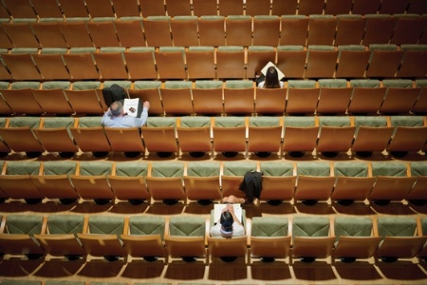

Slide 38
Student does something, into a desired direction, with feedback

Slide 39
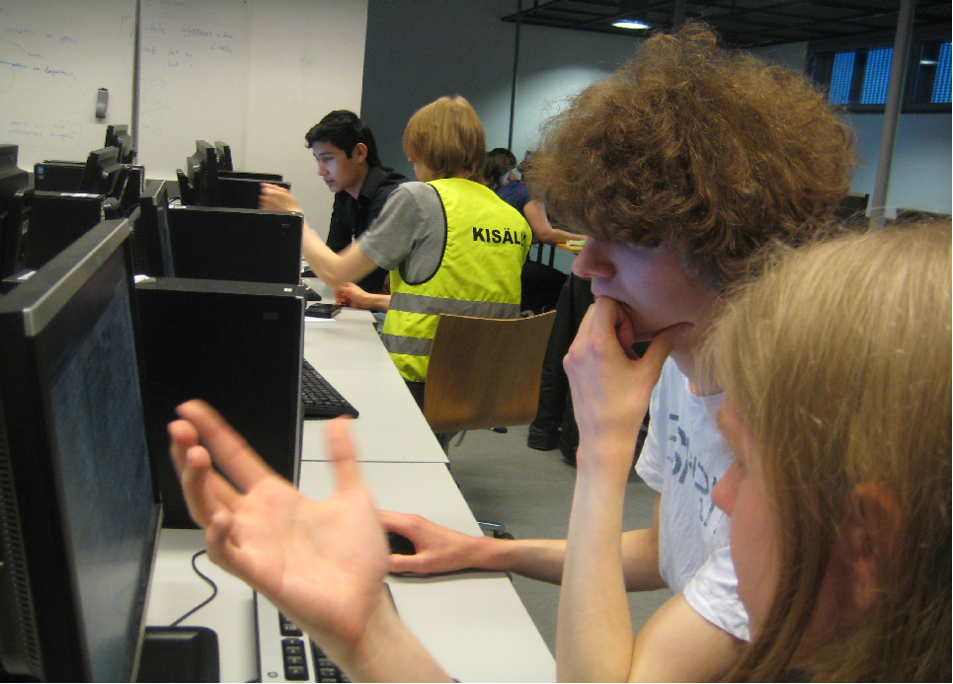

Slide 40
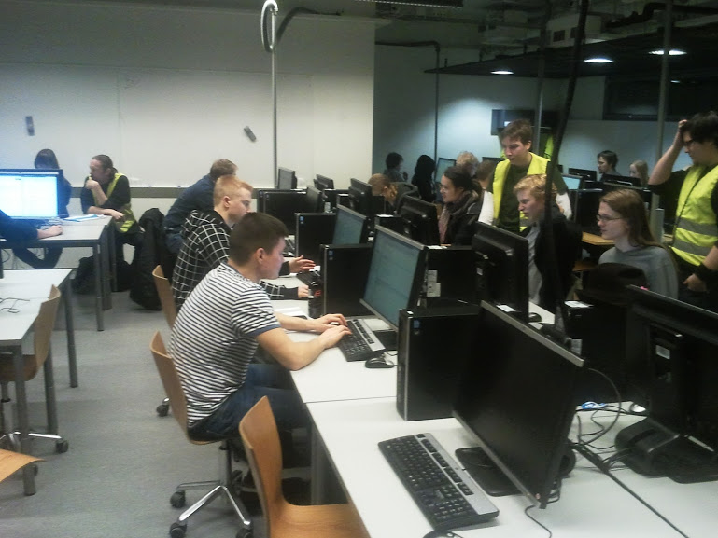

Slide 41
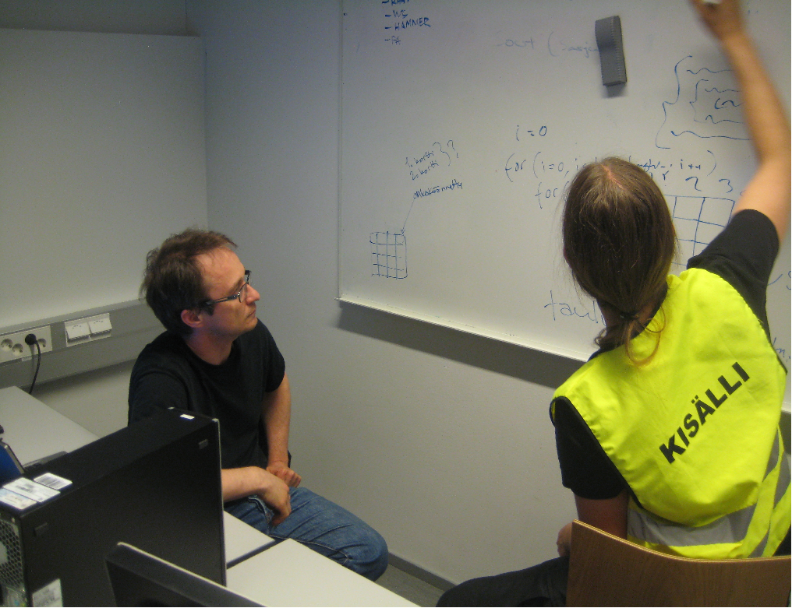

Slide 44
Constantly evidence that you are progressing

Slide 45
Empowering students:

Slide 46
Top-down: structures:
“everything looks good on paper”
Bottom-up: ownership of the learning environment
Student empowerment by the emergence of versatile learning activities

Slide 47
As soon as they can do stuff, let them: Pop-up Courses: Apps4finland, GameJam... Codecamps: Qt, Windows Phone, Android… Challenges: AI for Games, Competitive programming (ACM ICPC, IOI) Software Factory: Real-client projects with spinoffs

Slide 48
argue the value and relevance to students
day in, day out

Slide 50
Collins, 2001

Slide 51
Collins, 2001

Slide 52
Collins, 2001

Slide 53
Collins, 2001

Slide 54
UH’s pedagogical development model
Notes:
The success of the Academy has been possible because of the earlier strategic choices of the university; the establishment of the Centre for Research and Development of Higher Education (established at beginning of the 2000’s) and the network of senior lecturers in university pedagogy (established 1998).
The establishment of these networks has been significant and even internationally unique contribution to the development of the teaching.
The senior lecturers in university pedagogy at the faculties as well as the permanent research and teaching staff of the Centre for Research and Development of Higher Education serve as permanent expert members of the Teachers’ Academy. They support and coordinate the discipline-specific and interdisciplinary efforts to develop and investigate teaching; participate in organising events, visits and publications related to the development of University teaching together with the Teachers’ Academy; and serve as pedagogical experts on the Academy’s assessment panels.

Slide 55
UH’s pedagogical development model
Centre for
Research and Development
of Higher Education
Notes:
The success of the Academy has been possible because of the earlier strategic choices of the university; the establishment of the Centre for Research and Development of Higher Education (established at beginning of the 2000’s) and the network of senior lecturers in university pedagogy (established 1998).
The establishment of these networks has been significant and even internationally unique contribution to the development of the teaching.
The senior lecturers in university pedagogy at the faculties as well as the permanent research and teaching staff of the Centre for Research and Development of Higher Education serve as permanent expert members of the Teachers’ Academy. They support and coordinate the discipline-specific and interdisciplinary efforts to develop and investigate teaching; participate in organising events, visits and publications related to the development of University teaching together with the Teachers’ Academy; and serve as pedagogical experts on the Academy’s assessment panels.

Slide 56
UH’s pedagogical development model
Centre for Research and Development of Higher Education
Promotes and coordinates the scholarship of teaching
Conducts research on higher education
Provides courses on university pedagogy
Centre for
Research and Development
of Higher Education
Notes:
The success of the Academy has been possible because of the earlier strategic choices of the university; the establishment of the Centre for Research and Development of Higher Education (established at beginning of the 2000’s) and the network of senior lecturers in university pedagogy (established 1998).
The establishment of these networks has been significant and even internationally unique contribution to the development of the teaching.
The senior lecturers in university pedagogy at the faculties as well as the permanent research and teaching staff of the Centre for Research and Development of Higher Education serve as permanent expert members of the Teachers’ Academy. They support and coordinate the discipline-specific and interdisciplinary efforts to develop and investigate teaching; participate in organising events, visits and publications related to the development of University teaching together with the Teachers’ Academy; and serve as pedagogical experts on the Academy’s assessment panels.

Slide 57
UH’s pedagogical development model
Centre for Research and Development of Higher Education
Promotes and coordinates the scholarship of teaching
Conducts research on higher education
Provides courses on university pedagogy
Pedagogical university lectors
Centre for
Research and Development
of Higher Education
Notes:
The success of the Academy has been possible because of the earlier strategic choices of the university; the establishment of the Centre for Research and Development of Higher Education (established at beginning of the 2000’s) and the network of senior lecturers in university pedagogy (established 1998).
The establishment of these networks has been significant and even internationally unique contribution to the development of the teaching.
The senior lecturers in university pedagogy at the faculties as well as the permanent research and teaching staff of the Centre for Research and Development of Higher Education serve as permanent expert members of the Teachers’ Academy. They support and coordinate the discipline-specific and interdisciplinary efforts to develop and investigate teaching; participate in organising events, visits and publications related to the development of University teaching together with the Teachers’ Academy; and serve as pedagogical experts on the Academy’s assessment panels.

Slide 58
UH’s pedagogical development model
Centre for Research and Development of Higher Education
Promotes and coordinates the scholarship of teaching
Conducts research on higher education
Provides courses on university pedagogy
Pedagogical university lectors
Centre for
Research and Development
of Higher Education
Network of senior lecturers in university pedagogy
Faculty-level development and related pedagogical research
Faculty-level courses on university pedagogy
Notes:
The success of the Academy has been possible because of the earlier strategic choices of the university; the establishment of the Centre for Research and Development of Higher Education (established at beginning of the 2000’s) and the network of senior lecturers in university pedagogy (established 1998).
The establishment of these networks has been significant and even internationally unique contribution to the development of the teaching.
The senior lecturers in university pedagogy at the faculties as well as the permanent research and teaching staff of the Centre for Research and Development of Higher Education serve as permanent expert members of the Teachers’ Academy. They support and coordinate the discipline-specific and interdisciplinary efforts to develop and investigate teaching; participate in organising events, visits and publications related to the development of University teaching together with the Teachers’ Academy; and serve as pedagogical experts on the Academy’s assessment panels.

Slide 59
UH’s pedagogical development model
Centre for Research and Development of Higher Education
Promotes and coordinates the scholarship of teaching
Conducts research on higher education
Provides courses on university pedagogy
Teachers’ Academy
Pedagogical university lectors
Centre for
Research and Development
of Higher Education
Network of senior lecturers in university pedagogy
Faculty-level development and related pedagogical research
Faculty-level courses on university pedagogy
Notes:
The success of the Academy has been possible because of the earlier strategic choices of the university; the establishment of the Centre for Research and Development of Higher Education (established at beginning of the 2000’s) and the network of senior lecturers in university pedagogy (established 1998).
The establishment of these networks has been significant and even internationally unique contribution to the development of the teaching.
The senior lecturers in university pedagogy at the faculties as well as the permanent research and teaching staff of the Centre for Research and Development of Higher Education serve as permanent expert members of the Teachers’ Academy. They support and coordinate the discipline-specific and interdisciplinary efforts to develop and investigate teaching; participate in organising events, visits and publications related to the development of University teaching together with the Teachers’ Academy; and serve as pedagogical experts on the Academy’s assessment panels.

Slide 60
TEACHERS’ ACADEMY
Notes:
The Teachers' Academy logo, the acorn, stands for knowledge, a new beginning and the spread of wisdom. It is a sign of the distinguished university teacher as an inspirer of learning.
The oak tree, a symbol of knowledge and wisdom, stands for community and the Teachers' Academy as a network of scholarly teachers. It evokes the idea of a university community that is proud of its teachers, appreciates their skills and encourages them in their quest for better teaching.

Slide 61
Reward system
The selected teachers are recognised as permanent members of the Academy and receive a personal (10 000 € / year / 2 years).
The teacher’s home unit: grant for its development of teaching (15 000 € / year / 2 years).
Notes:
Each member of the Teachers’ Academy receives a two-year grant of 10,000 euros per year. The grant must be used towards professional development.
The new member’s home unit (department, group of disciplines, discipline or equivalent) is awarded performance-based funding of 15,000 euros per year for each rewarded teacher. This funding is provided for two years and must be used for the development of teaching (e.g., pedagogical training or various teaching experiments). The allocation of the funding must be subjected to discussion in the unit, taking into consideration suggestions and ideas from the rewarded member(s) and the entire community. Unit heads must ensure that the funding is allocated to teaching development. Separate instructions have been issued for the use and conditions of these grants.
Examples of the use of the personal grant:
international pedagogical conferences
projects or experiments related to the development of teaching (incl. various pilot and project-based courses)
acquisitions related to teaching and educational technology, such as laptops, tablet computers, simulators, game licences, anatomical models, equipment for teaching laboratories and classrooms for calculation exercises, and the digitisation of collections of teaching specimens
Production and publication of learning materials related to teacher’s own field of science
teaching-related visits to a university abroad
participate in a course or training related to the development of teaching
Examples of the use of unit’s grants:
development days and seminars
projects and teaching experiments
acquisitions related to teaching and educational technology
research and reports related to the development of teaching (e.g. survey of student experiences at the faculty, the research and development of methodological teaching combining the natural and human sciences, the collection of student experiences of exchange arrangements, and a review of student experiences of Bachelor’s and Master’s thesis seminars and supervision)
international pedagogical conferences
visits to universities outside Finland
production and acquisition of learning material
>> The funding has been used in diverse and innovative ways. It has clearly enabled investments in pedagogical development, which are really necessary for high-quality teaching in the research-intensive context.
It is particularly commendable that the funding has enabled participation in international pedagogical conferences as well as pedagogical research. Many teachers feel (according the enquiry of the use of funding) that department grants are barely sufficient for academic conferences in one’s own field. International pedagogical conferences may also be expensive, which may prohibit teachers from attending them in addition to academic conferences. Participation in pedagogical conferences has, however, provided many Academy fellows with new perspectives on teaching and learning and allowed them to create new networks, and thus, promote the long-term development of teaching.
It is also particularly important and positive that the Teachers’ Academy funding has been used for collaborative efforts to develop teaching. Comments from many teachers show how the entire community has benefited from a single teacher being recognised. In addition, it is important and impressive for the University to find that its investment in the Teachers’ Academy has led to a permanent change of culture in units and that many experiments and acquisitions will provide enduring or long-term benefits for teaching and learning.
The total costs of the Academy have been 620 000-1 270 000 euros / the year.
2013 2104 2015 2016
(Number of members) (30) (30 + 20) (20+20) (no new members)
Personal funding, 10.000 € / member 300 000 500 000 400 000 200 000
Unit funding 15.000 € / member 450 000 750 000 600 000 300 000
General expenses (common activities) - 20 000 20 000 20 000
Total 750 000 1270 000 1 020 000 550 000
The number of the members and the amount of the funding after year 2017 are still open.

Slide 62
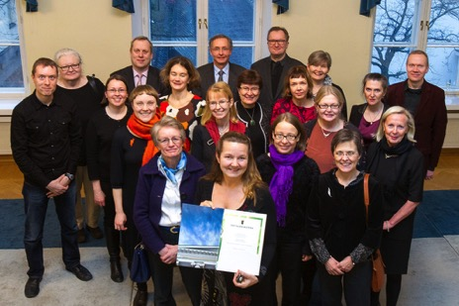
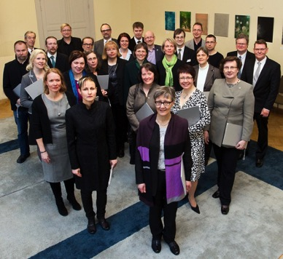
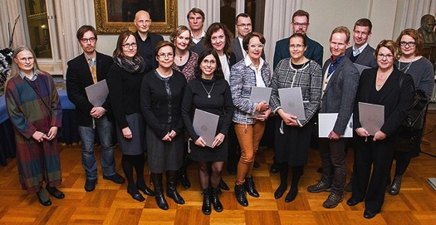
network of top teachers
30 founding members 2013 20 fellows 2014 20 fellows 2015 10 new fellows 2017
Notes:
Applications have been invited once a year (a total of three application rounds so far).
Application statistics 2012-2014
APPLICANTS 2012 2013 2014
Applicants altogether 132 69 81
Men 39% 45% 30%
Professors 16% 7%* 22%
University lecturers 59% 63% 54%
University instructors 9% 9% 7%
ACCEPTED 2012 2013 2014
Accepted** altogether 30 20 20
Men 43% 40% 25%
Professors 33% 5%* 30%
University lecturers 63% 75% 65%
University instructors 3% 5% -
* In 2013 the end of the application period for the Academy was at the same time than the end of the application period of Academy of Finland research grants > Lower the number of professors
** The maximum amount of accepted was set in advance – based on the reserved fundings
There have been applicants from all the faculties.

Slide 63
Thank you!

