Slide 1
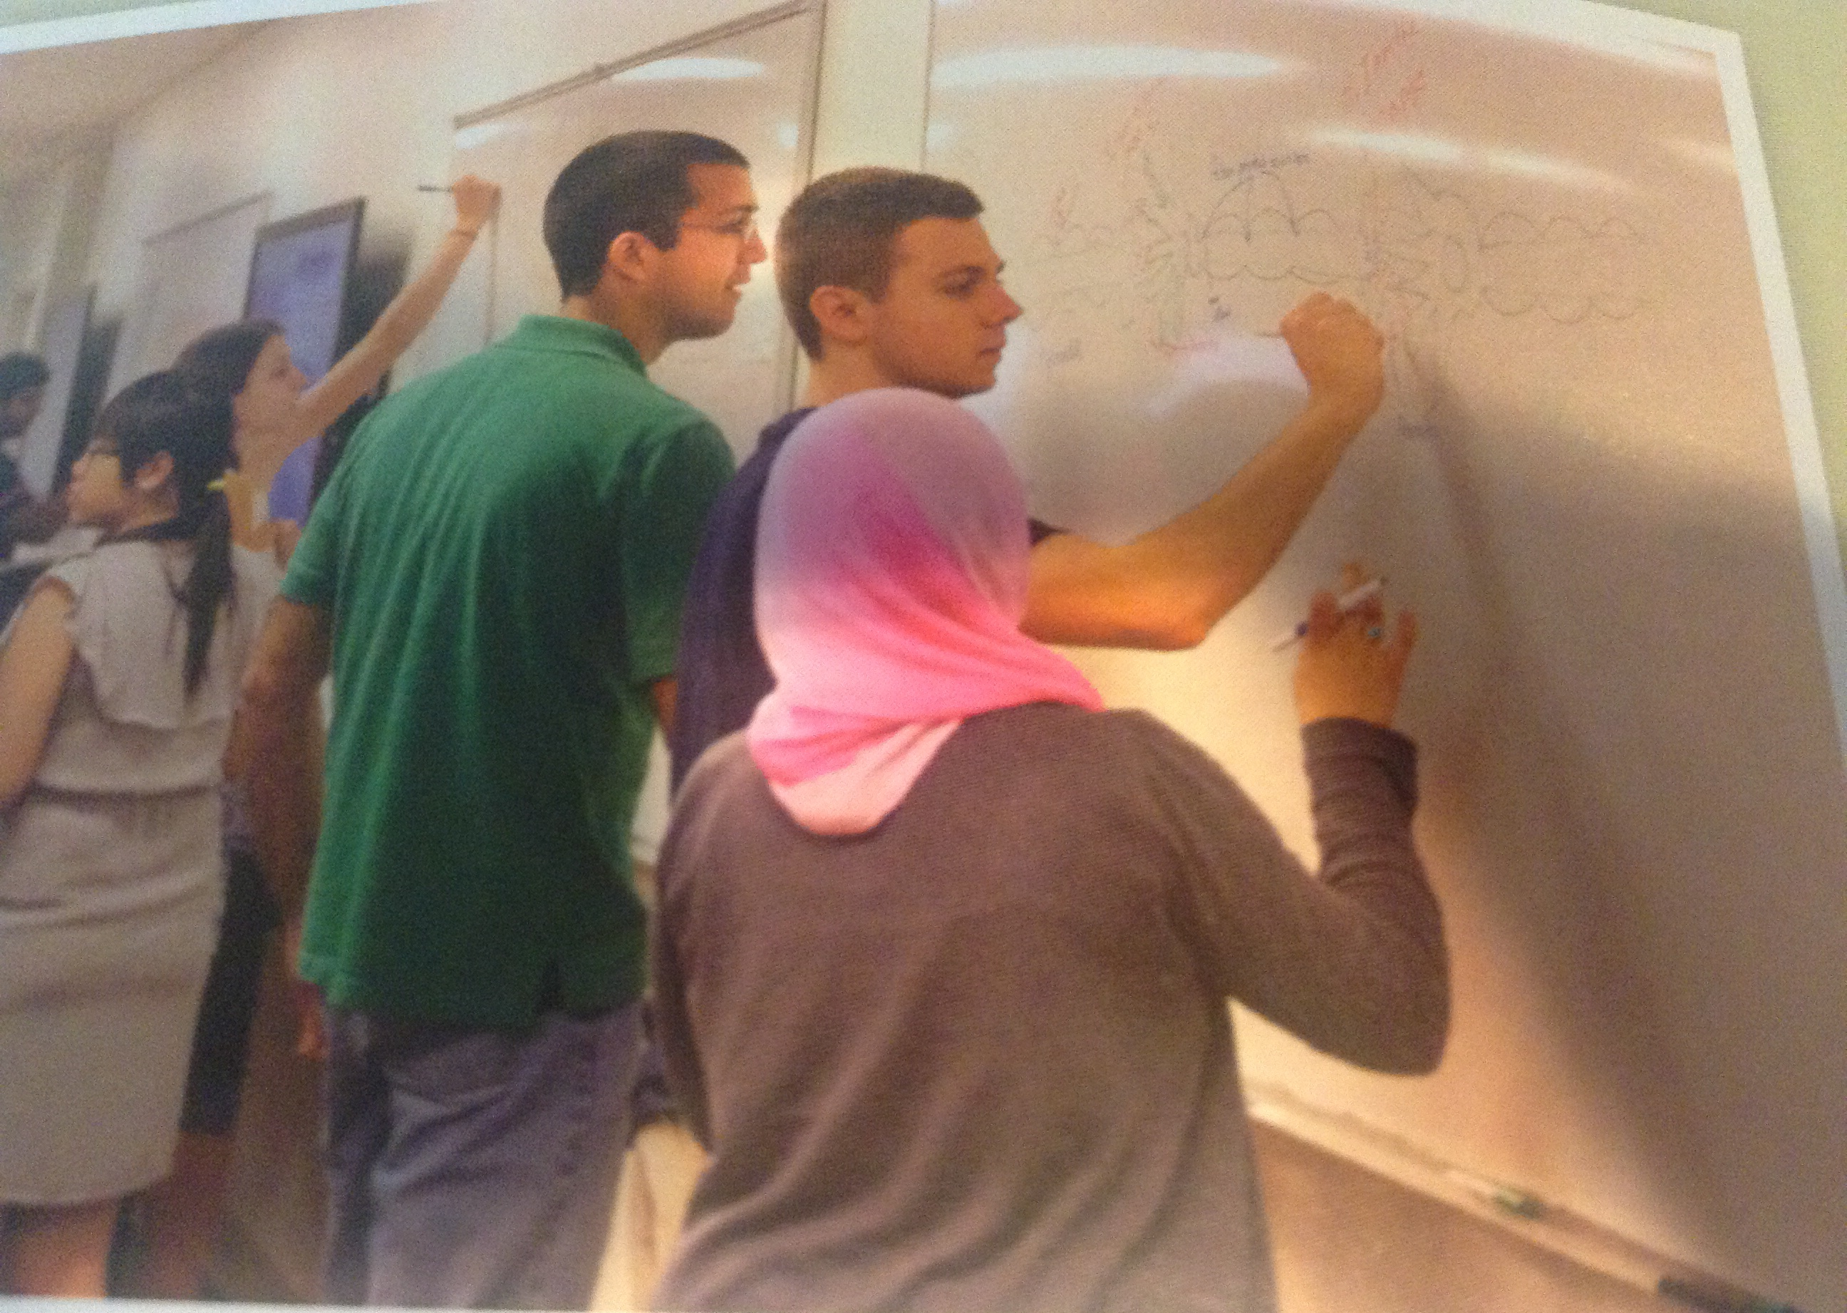
Evidence-Based Teaching
And Institutional Change
Sarah Leupen, University of Maryland Baltimore County;
Visiting Faculty, Lékařská Fakulta v Plzni, Univerzita Karlova v Praze

Slide 2
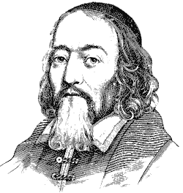
Let the main object be ... to seek and to find a method of instruction, by which teachers may teach less, but learners learn more.
– Jan Amos Komenský
1592-1670
Notes:
“Learners learn more” makes sense, but why do we say “teachers teach less”?

Slide 3
How Do People Learn Best?
Audio-visual
Demonstration
Discussion
Lecture
Practice
Reading
Teaching others
Source: NTL Institute for Applied Behavioral Science http://homepages.gold.ac.uk/polovina/learnpyramid/about.htm

Slide 4
How Do People Learn Best?
teaching
Student talking
practice
Instructor talking
discussion
demonstration
audio-visual
reading
lecture
Source: NTL Institute for Applied Behavioral Science http://homepages.gold.ac.uk/polovina/learnpyramid/about.htm
Notes:
Note, an instructor is still needed! … like a coach: organizing, defining goals and practices, and providing expertise. ... So, how do we actually know these things? Over the past 20 years we have finally started to study teaching scientifically, and advances in cognitive science have also helped us understand how learning works.

Slide 5
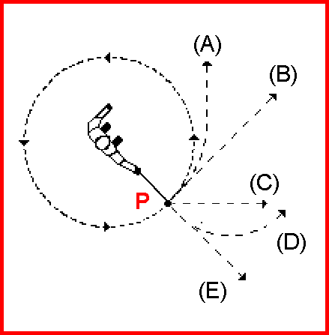
Force Concept Inventory: Example
A steel ball is attached to a string and is swung in a circular path in a horizontal plane as illustrated here.
At the point P indicated in the figure, the string suddenly breaks near the ball.
If these events are observed from directly above, which path would the ball most closely follow after the string breaks?
Notes:
What is the answer here?
The correct choice is B, but most students do not choose it even after a semester of study.

Slide 6
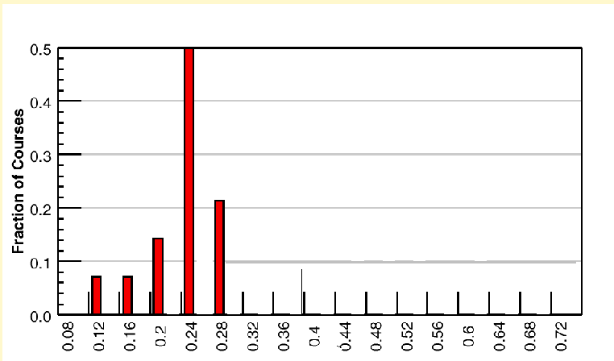
Force Concept Inventory: Gain
14 traditional introductory physics courses
2084 students
Hake R. Interactive Engagement versus Traditional Methods. Am. J. Physics 66: 64 (1998).
Notes:
Essentially, the students are still Aristotaleans at the end of the semester. Just like with the cystic fibrosis question I started with, physics students can get good grades by solving equations, without any true conceptual understanding of physics.
A lot of physicists were alarmed, studied the problem and to make a long story short, learned that you could improve learning if you:
Asked the students conceptual questions during class time
Allowed students to interact with each other to discuss the questions, and c
Give students immediate feedback on the questions.

Slide 7
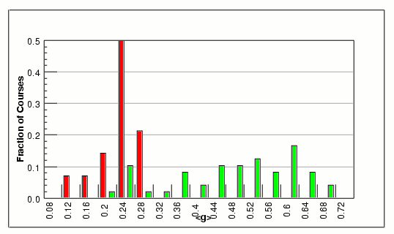
Force Concept Inventory: Gain
62 introductory physics courses
6542 students
Traditional
Interactive Engagement
Hake R. Interactive Engagement versus Traditional Methods. Am. J. Physics 66: 64 (1998).
Notes:
When you do that, this happens. But this is a variety of classes, not a well-controlled study. When you do a well-controlled study you get the same results:

Slide 8
Improving Learning in Physics
Deslauriers et al. 2011. Improved Learning in a Large-Enrollment Physics Class. Science 332:862
Notes:
Comparison of Week 12 change only in two large-enrollment introductory physics courses. Same test for students in each section. Enrollment and enthusiasm of the students were also higher.
This was then developed in chemistry and biology and there have now been hundreds of studies that support this result in physics. A large meta-analysis of these studies was done two years ago and widely publicized. Here are its results:

Slide 9
Notes:
The odds ratio is 1.95 to pass the course vs. lecturing. You are perhaps used to looking at data for drug efficacy. Which drug would you recommend if we want our students to learn more, lecture or active learning?

Slide 10
“If these experiments had been conducted as randomized controlled trials of medical interventions, they may have been stopped for benefit—meaning that enrolling patients in the control condition might be discontinued because the treatment being tested was clearly more beneficial.”
Notes:
… OK, now let’s be more specific about which methods work. Just giving students a problem to solve can be a disaster. What do we need to do to do it right?

Slide 11
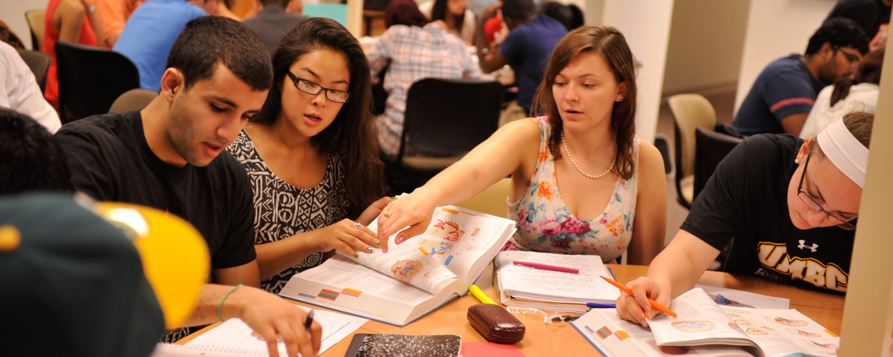
Which Practices Help Students Learn?
Having students apply information during class time
Notes:
[And explain survey]

Slide 12
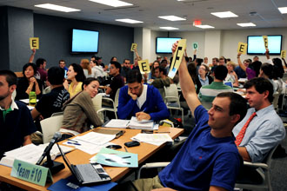
What Practices Help Students Learn?
Having students use and apply information during class time
Giving students immediate feedback on their understanding
Notes:
But not necessarily electronic feedback!

Slide 13
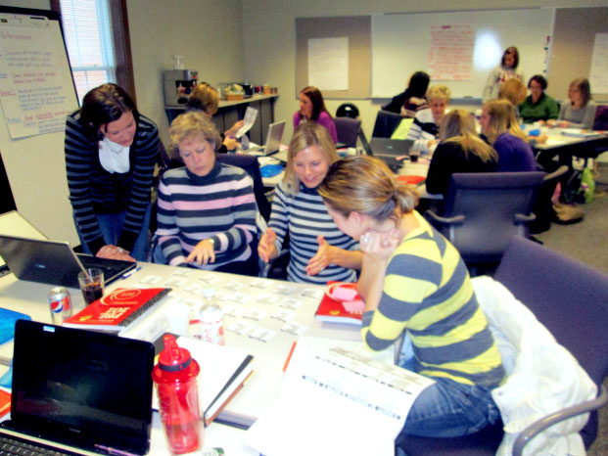
What Practices Help Students Learn?
Having students use and apply information during class time
Giving students immediate feedback on their understanding
Having students work in class in cooperative teams
Notes:
… And even if you don’t care if your students learn to work in a team as a specific skill, the fact is that students learn more this way even if they never work on a team again. And this is very surprising! Why is it useful for them to talk to other uninformed, ignorant people? We have some clues that looked at a subset of this problem. We know that if we give students a “clicker” question, they vote, discuss, and revote, they do better the second time. But why? :

Slide 14
UCLA students all read the same passage about the Crimean War
Some expected to take a test on it, and others expected to be asked to teach it to others
Actually, they all just took a test
Notes:
Read a passage about the Crimean War, UCLA

Slide 15
Nestojko et al. Mem Cogn 21 May 2014
Notes:
… And really, this is not new information:

Slide 16
What Practices Help Students Learn?
Having students use and apply information during class time
Giving students immediate feedback on their understanding
Having students work in class in cooperative teams
Having students get basic facts about the topic before class

Slide 17
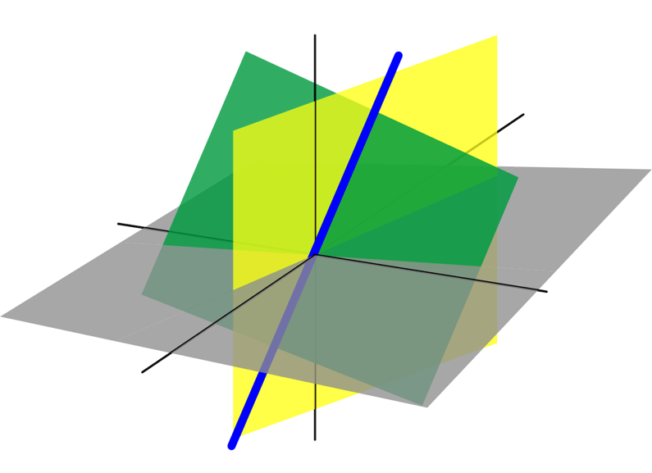
Redesigning a class: an example
Linear Algebra taught using traditional lectures in Fall 2011 and Spring 2012
Used Team-Based Learning in Fall 2012 and Spring 2013
Homework assignments, difficulty of quizzes and exams were held constant
Notes:
Note, TBL is used at many medical schools.

Slide 18
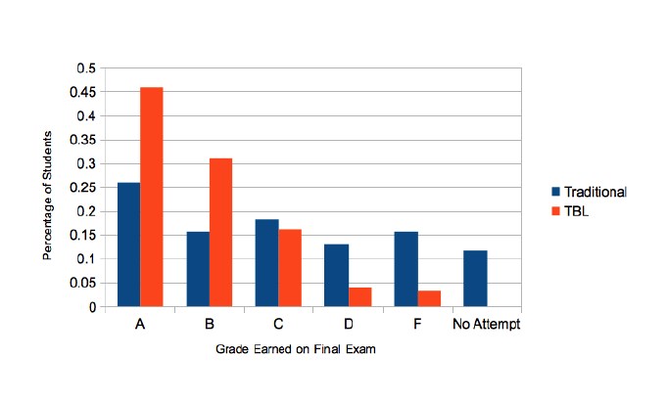
K. Nanes, TBL in Linear Algebra, Intl. Journal of Math. Ed. 2014
Notes:
Even though the “dumb kids” showed up for the final exam.

Slide 19
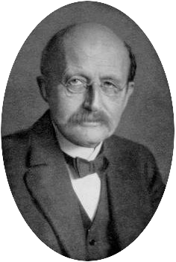
A new scientific truth does not triumph by convincing its opponents and making them see the light, but rather because its opponents eventually die, and a new generation grows up that is familiar with it.
-- Max Planck
1858-1947
Notes:
One of the most amazing things cognitive science has taught us is that people aren’t convinced by evidence. This quote is often paraphrased as “Science advances one funeral at a time”. Even for those who buy in, it’s not easy:

Slide 20
Barriers to Change
The incentive system penalizes all time away from research

Slide 21
Barriers to Change
The incentive system penalizes all time away from research
Our only measures of teaching are student evaluations, not student learning or use of effective practices

Slide 22
Barriers to Change
The incentive system penalizes all time away from research
Our only measures of teaching are student evaluations, not student learning or use of effective practices
Change often requires collaboration among many instructors

Slide 23
Barriers to Change
The incentive system penalizes all time away from research
Our only measures of teaching are student evaluations, not student learning or use of effective practices
Change often requires collaboration among many instructors
Teaching spaces are often not well-designed for best practices

Slide 24
How Can Institutions Create Change?
“Large-Scale Experiments in Institutional Change”
Notes:
This question has itself been examined scientifically.

Slide 25
Core Features of the Science Education Initiative
Department-Centered (entire departments)

Slide 26
Core Features of the Science Education Initiative
Department-Centered (entire departments)
One-time only competitive grant program for departments to get a science education specialist

Slide 27
Core Features of the Science Education Initiative
Department-Centered (entire departments)
One-time only competitive grant program for departments to get a science education specialist
“Science Education Specialists” helped faculty transform their courses over time

Slide 28
Core Features of the Science Education Initiative
Department-Centered (entire departments)
One-time only competitive grant program for departments to get a science education specialist
“Science Education Specialists” helped faculty transform their courses over time
→ Goal was to have a permanent impact with a one-time investment

Slide 29
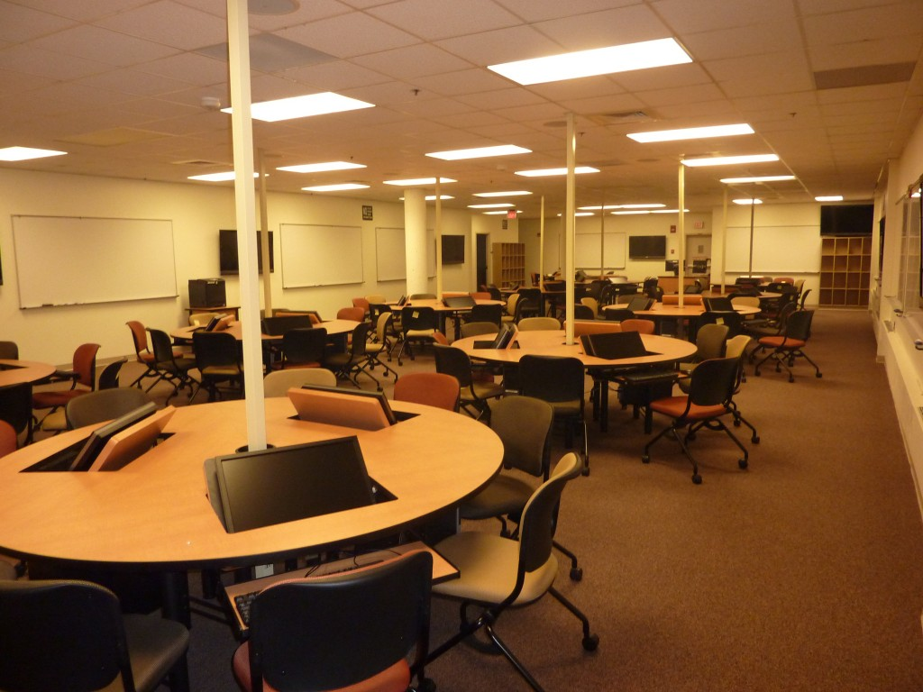
Common Mistakes Avoided
Fancy new teaching spaces

Slide 30
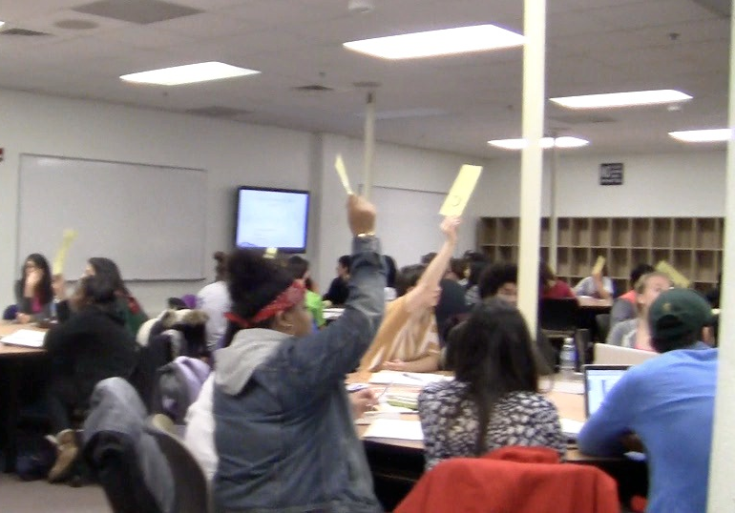
Common Mistakes Avoided
Fancy new teaching spaces

Slide 31
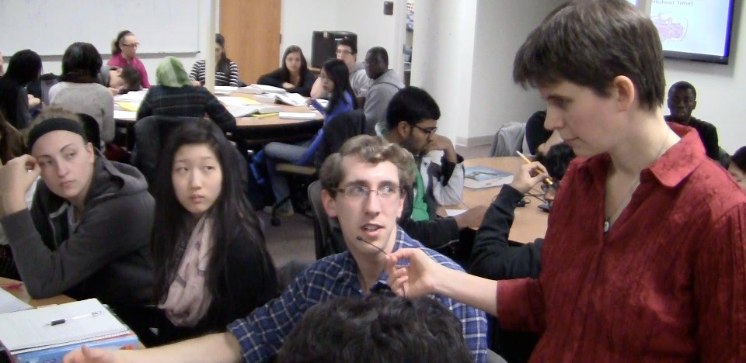
Common Mistakes Avoided
Fancy new teaching spaces

Slide 32
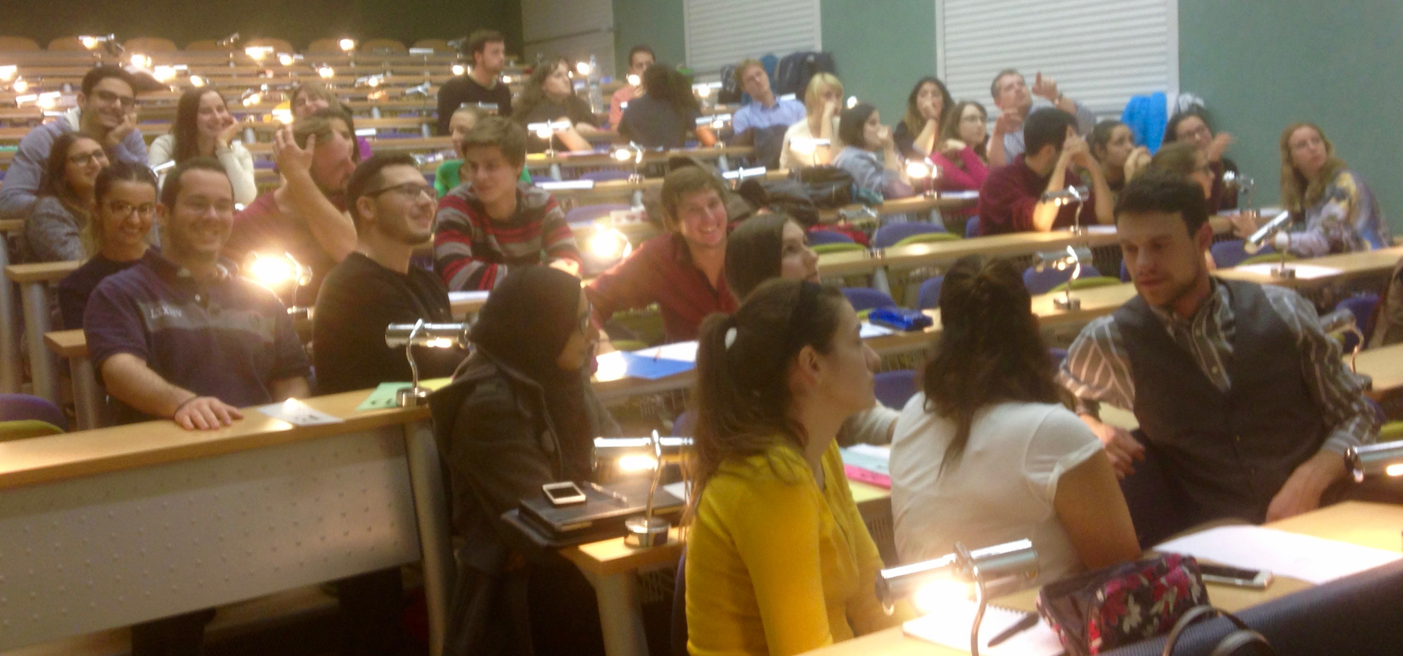
Common Mistakes Avoided
Fancy new teaching spaces

Slide 33
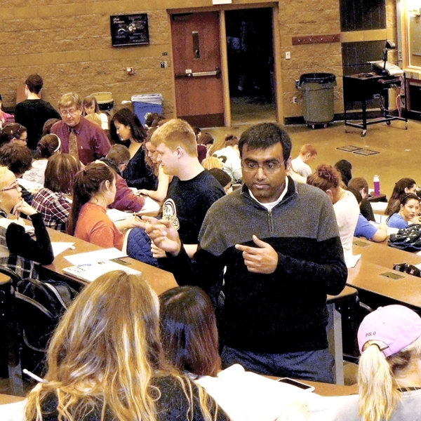
Common Mistakes Avoided
Fancy new teaching spaces
Reduction in class size
Notes:
Organic Chemistry class at Purdue with 250 students

Slide 34
Common Mistakes Avoided
Fancy new teaching spaces
Reduction in class size
Changing individuals instead of department culture

Slide 35
Common Mistakes Avoided
Fancy new teaching spaces
Reduction in class size
Changing individuals instead of department culture
Focusing on curriculum instead of best practices and student learning

Slide 36
Common Mistakes Avoided
Fancy new teaching spaces
Reduction in class size
Changing individuals instead of department culture
Focusing on what to teach instead of best practices and student learning
Large ongoing/permanent costs

Slide 37
Notes:
Slide from Carl Weimann.

Slide 38
Effect of SEI program on
Effective Teaching Practices
Notes:
this is for ALL courses in department

Slide 39
Recommendations
1. Provide concrete incentives to departments and to individuals to change
“The dominant barrier to improving teaching is the formal incentive system.” – Carl Weimann
Notes:
This also means changing teaching evaluations.

Slide 40
Recommendations
Provide concrete incentives to departments and to individuals to change
Make faculty aware of best practices in teaching and the evidence base for those practices
Most faculty want to teach well, and want their students to learn a lot.
Notes:
Making this into an adversarial thing is the same problem as when we do that with our students.

Slide 41
Recommendations
Provide concrete incentives to departments and to individuals to change
Make faculty aware of best practices in teaching and the evidence base for those practices
Create communities of practice:
Teaching Circles
Notes:
Making this into an adversarial thing is the same problem as when we do that with our students.

Slide 42
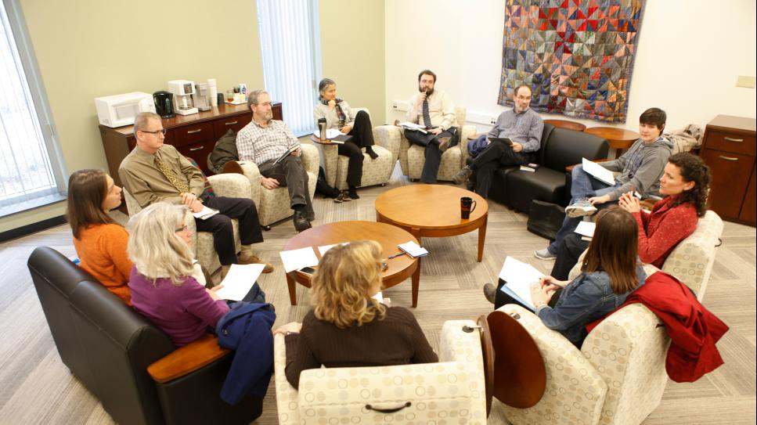
Teaching Circles
Examine and discuss the literature of teaching
Support department-level change
Maintain changes through difficulties
Notes:
This is just applying our understanding about change/learning at the faculty level. Individual accountability, but in teams.

Slide 43
Achieving widespread use of better teaching methods is possible!

Slide 44
The proper education of the young does not consist in stuffing their heads with a mass of words, sentences, and ideas dragged together… but in opening up their understanding to the outer world, so that a living stream may flow from their own minds, just as leaves, flowers, and fruit spring from the bud on a tree.
-- Jan Amos Komenský
1592-1670

